Slide 1
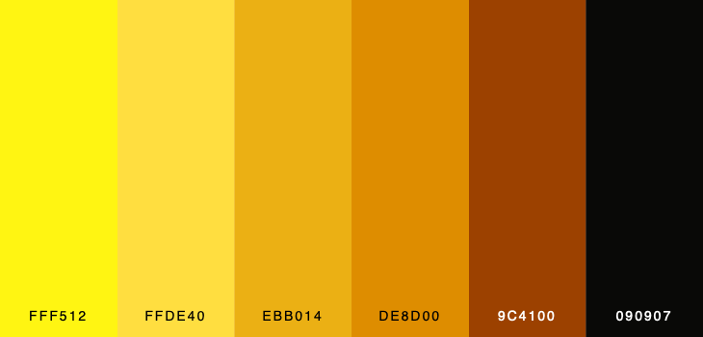

PLAYERUNKNOWN'S BATTLEGROUNDS
Crossroad of eSports & Business Analytics
By Valerii Ginak, Nancy Hakobjanyan and Miguel Herraez
Supervised by Carlos Carrasco Farre

Slide 2



The Team
Miguel Herraez Escudero
Nensi Hakobjanyan
Valerii Ginak

Slide 3
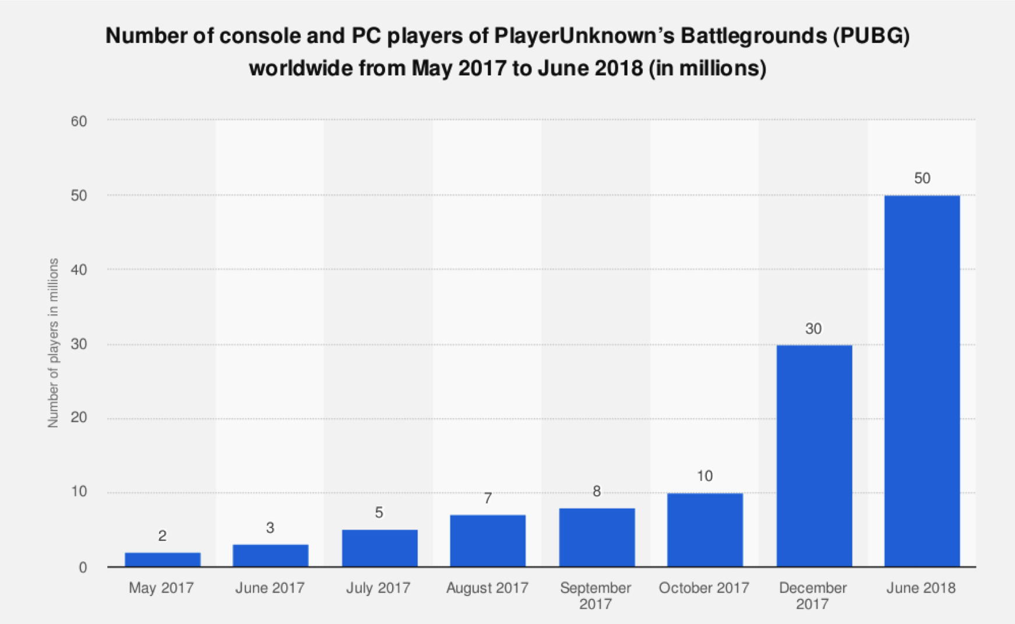
Player’s Unknown BattleGrounds
One of the top battle royale shooters
Has more than 50 million downloads
5th best sold game of all time

Slide 4
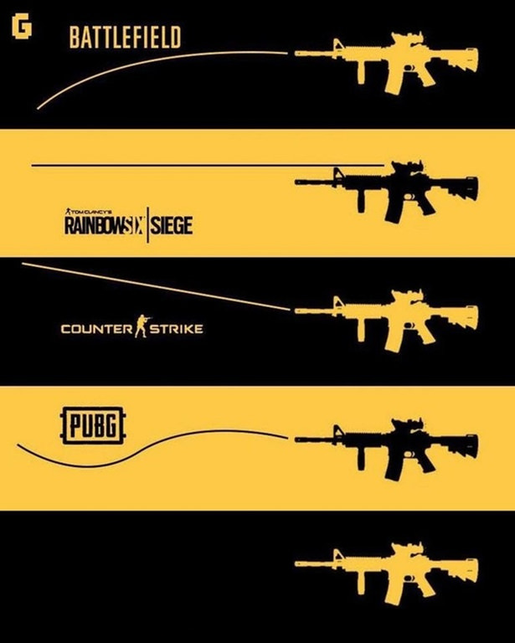
The problem
Discovering how collaboration affects team performance in eSports
What type of collaboration leads to more wins?
We need to build a system to collect the PUBG API data, clean the data, analyze behavioral data of team players and identify the different strategies to out survive the other teams in addition to find out the most attractive places to collect resources and weapons.

Slide 5


Our goals
Goal 1
Goal 2
Understanding the role of collaboration in performance (from strong to loose collaboration)
Understanding the role of risk-taking behaviour in performance (exploration strategies vs exploitation strategies)

Slide 6

Added value to society
Gaining understanding on human behaviour related to collaboration and teamwork.
Proving the potential of eSports data as experimental data to analyze and understand behavior in different contexts.

Slide 7
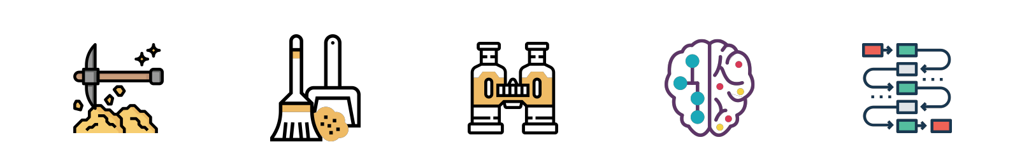
Work Done
OBTAIN
CLEAN
EXPLORE
MODEL
INTERPRET
API data collection
Heatmaps
Players’ distance
Team ranking
Players’ experience
Aggregated all the automation functions to extract data frames from the API.
Once all datasets were collected we conducted an EDA.
Builded predictive models, to assess effect of collaboration on performance.
Obtained results and interpreted them in a real-life business setting.

Slide 8
API data collection
Goal: Understanding and collecting the necessary raw data from the different API endpoints in order to build our datasets
Problems encountered:
Unfamiliarity with API processes and communication
Rate limits that slow data collection (/players endpoint presents a limit of 10 requests per minute)
Current state: Automated all of the API processes we require for our work (telemetry data collection from /matches endpoint and in process of automating rankpoint collection from /players endpoint) and raised rate limit up to ??? requests per minute

Slide 9
API data collection: Types of data
Match telemetry data: raw data containing events happening inside the match. From this we collect:
Location of players at different points in time
Parachute landing location
Item pickup and dropout events
Match information (ranking, type of match, map, players in the match)
Player data: we use this to get information about the experience of the players

Slide 10
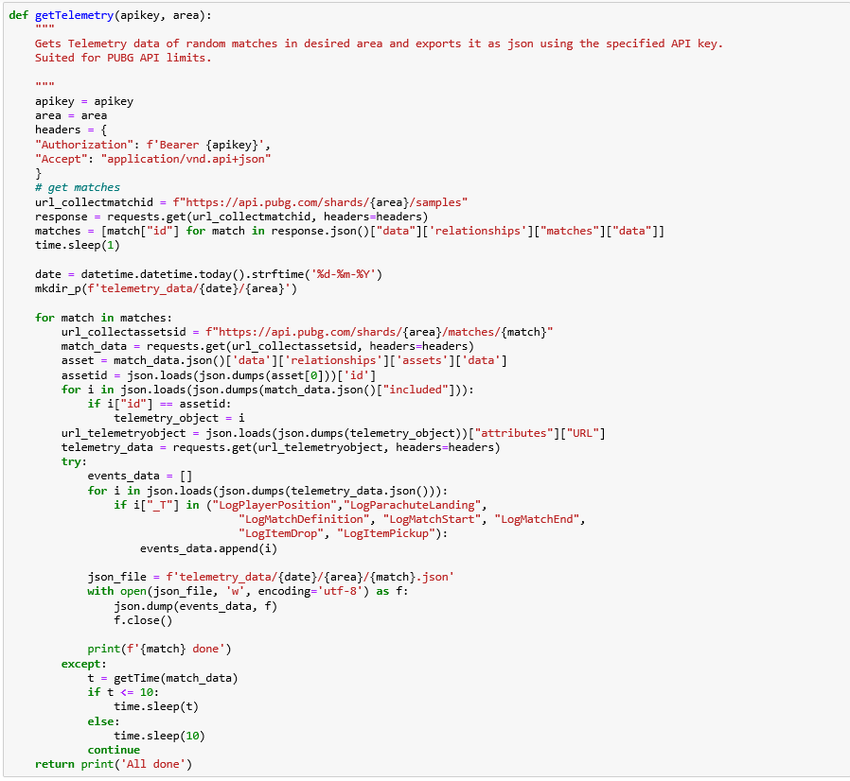
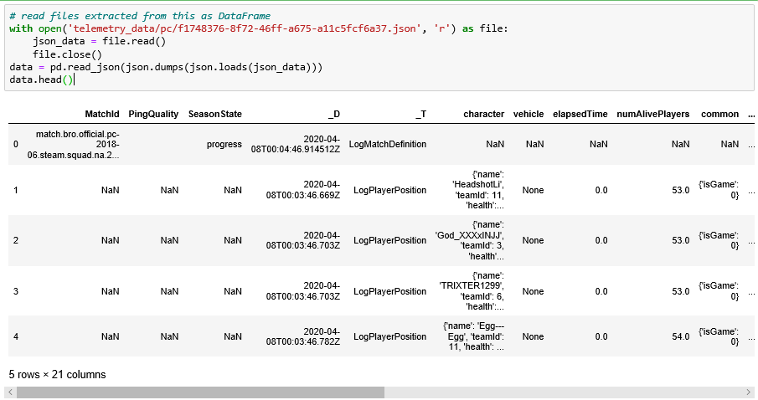
Matches raw telemetry data collected until today:
?????
Example of a function built to extract raw Telemetry data and example of raw data (we currently have data on around 40k matches from running this code daily)
Notes:
We can get rid of this, I just put it in case we wanna show it hahaha

Slide 11
2. Data preparation

Slide 12
2.1. Location data
Goal: This is the main information we want to analyze. In order to understand how players collaborate, we use the distance among players in the same teams through the match.
Problems encountered:
Harmonizing the locations along time (the data showed different moments in time for different players)
Building the function that properly calculated all distances based on location
Creating a categorical variable for the different types of collaboration
Current state:
Output variables: distance1_2_x, distance1_3 _x, distance1_4 _x, distance2_3 _x, distance2_4 _x, distance3_4 _x, distance_centroid1 _x, distance_centroid2 _x, distance_centroid3 _x, distance_centroid4 _x, cluster_A _x, cluster_B _x, cluster_C _x, cluster_D _x, n_players_y, distance1_2_y, distance1_3 _y, distance1_4 _y, distance2_3 _y, distance2_4 _y, distance3_4 _y, distance_centroid1 _y, distance_centroid2 _y, distance_centroid3 _y, distance_centroid4 _y, cluster_A _y, cluster_B _y, cluster_C _y, cluster_D _y, agility_y

Slide 13
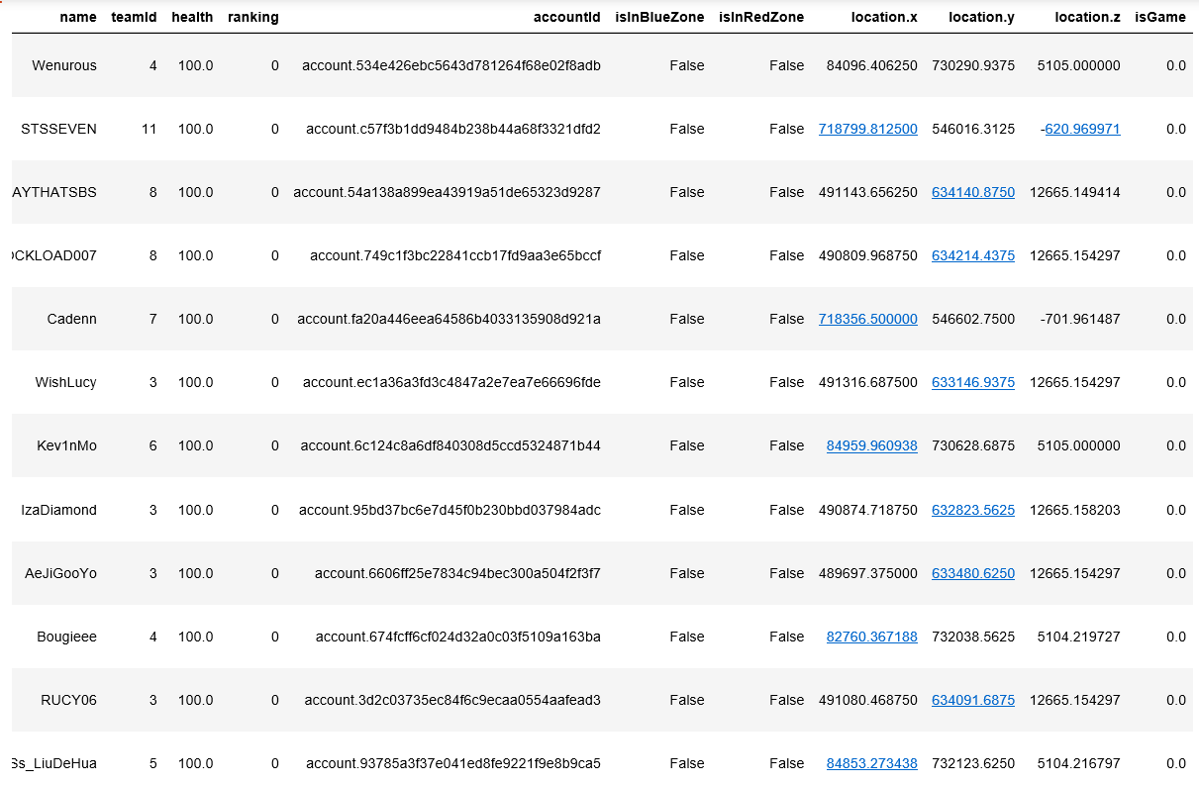
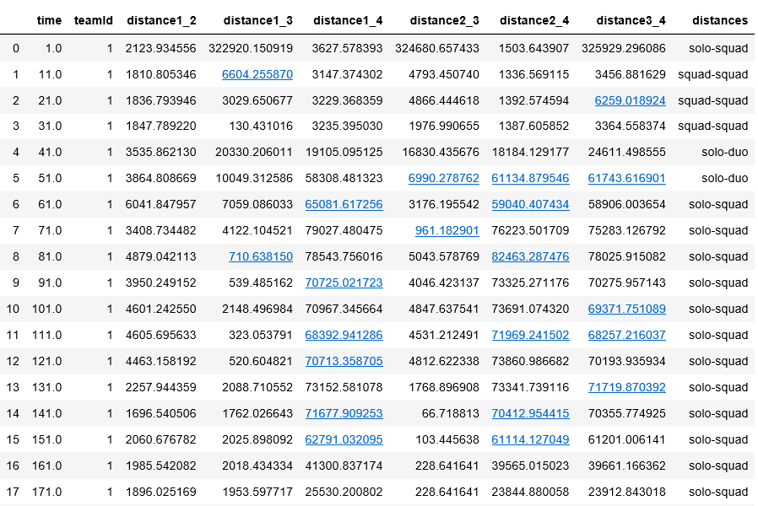
To this
From this
Notes:
We can get rid of this, I just put it in case we wanna show it hahaha

Slide 14
2.2. Risk taking data
Goal: We want to know whether landing and being in risky areas is a good strategy. To do it we need to collect landing data and create a heatmap. Then we can create a variable that states whether player lands or is located in a risky area or not.
Problems encountered
Need to differentiate between different maps
Founding a way to extract data and store it as a heatmap
Adding risk variable to the cleaned location data
Current state: We have collected and transformed enough data to successfully create heatmaps for four active maps and added risk variables to cleaned data
Output variables: landing_risk1, landing_risk2, landing_risk3, landing_risk4, risk1, risk2, risk3, risk4, risk_std1, risk_std2, risk_std3, risk_std4,

Slide 15
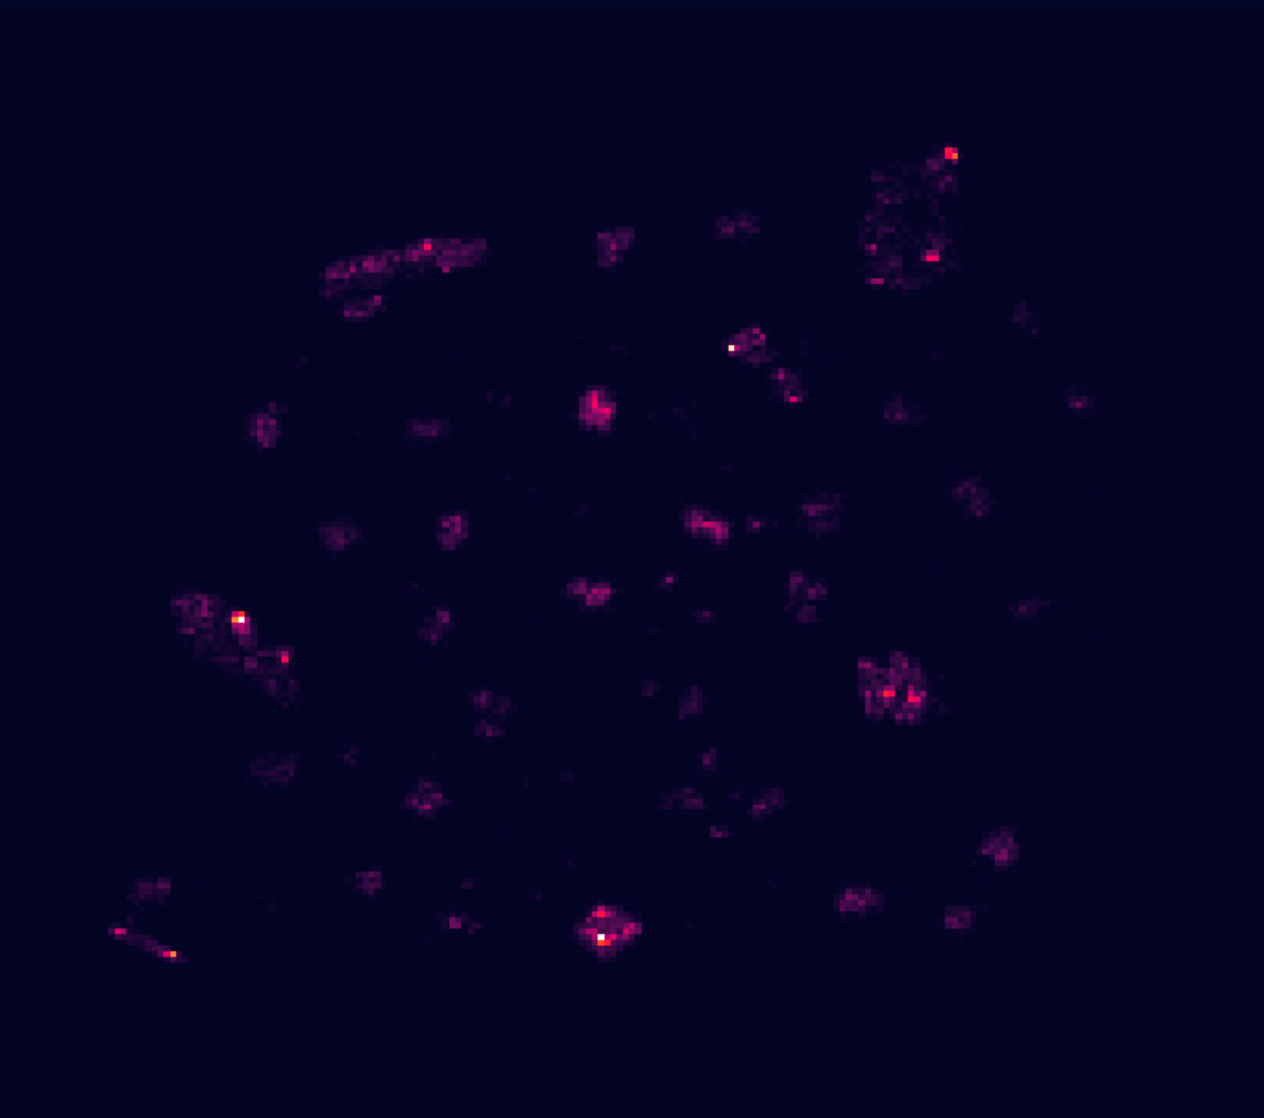
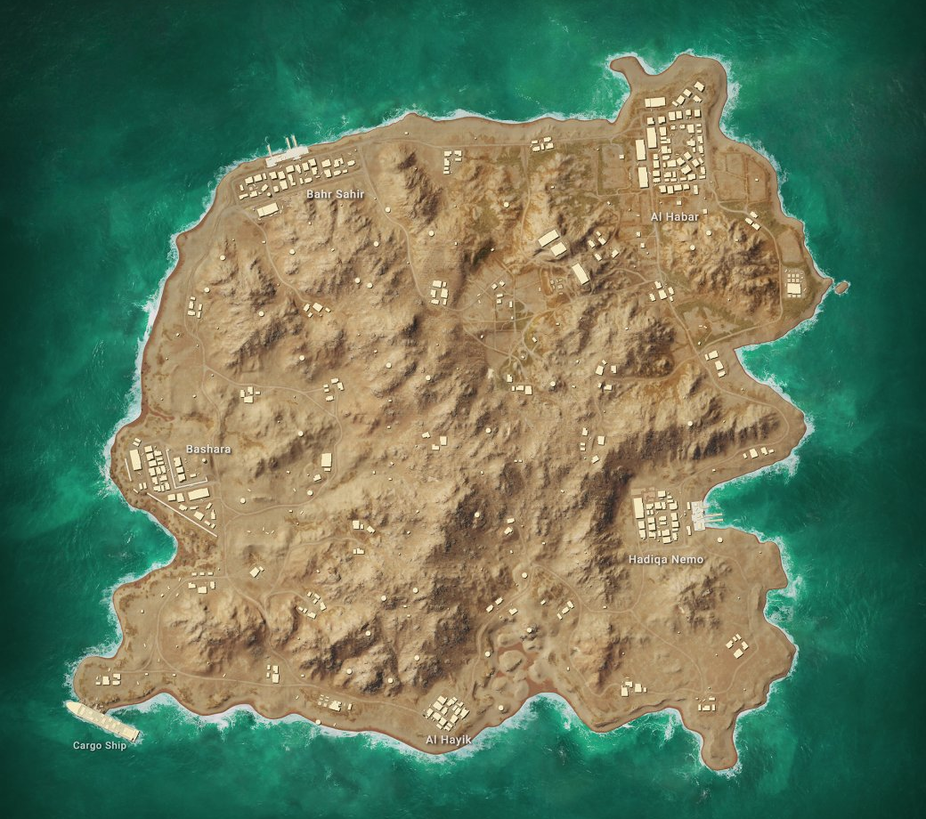
Heatmap: Karakin

Slide 16

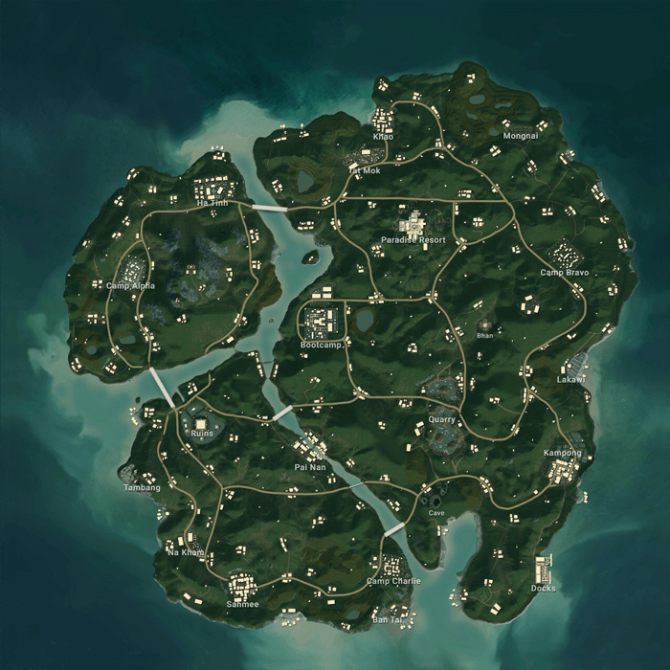
Heatmap: Sanhok

Slide 17
2.3. Ranking data
Goal: Ranking is our target variable. We want to understand how collaboration affects the overall performance of the team, being “winning” the common goal for all teams.
Problems encountered
Differences in individual and team rankings that lead to confusion
Current state: Decided to go with team as our unit of analysis. Therefore, ranking we take team ranking as target variable. Function to extract this data is built and fully automated.
Output variable: ranking

Slide 18
2.4. Player Experience: Rankpoints
Goal: By including rank points, we control for the experience of the players. It will allow to see the clear effect of distance among players on the team performance.
Problems encountered
Need to pull vast amount of data from a different endpoint-Season Stats
Building a function to differentiate between console and PC matches
Current state: Rank points for each player in the matches collected are extracted and summed, merging is done.
Output variable: exp

Slide 19
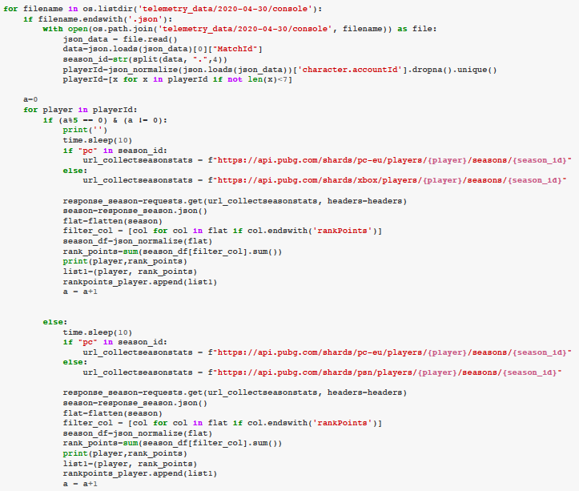
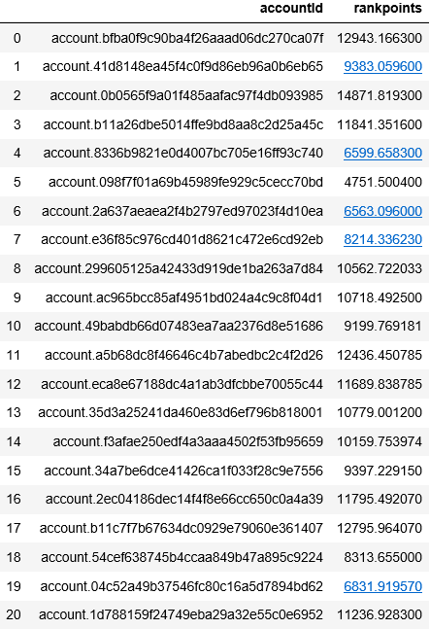
Automation Function:
AccountId: Season Rank Points

Slide 20
3. Exploratory data analysis
Goal:
Problems encountered
Size of the data
Current state: Distributions and correlations are done, cluster A is dropped

Slide 21
4. Models
Goal:
Problems encountered
Size of the data
Current state: Distributions and correlations are done, cluster A is dropped

Slide 22

We are proud of...
In-depth understanding of API documentation, which allowed us to maneuver freely in the process of building the data structures
Building several complex functions to automate API requests and data collection process
Visualizations of heat maps to assess the riskiness of areas for landing

Slide 23
Thank You!
Any Questions?

